Slide 1



Pima Community College
Electronics Payload Team
Jimmy VanWormer, Alfred Dugi,
Tom Goss
21th Annual Arizona Space Grant Symposium
April 21, 2012
University of Arizona

Slide 2
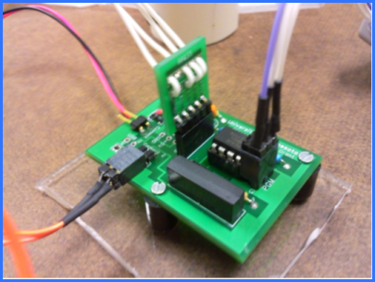
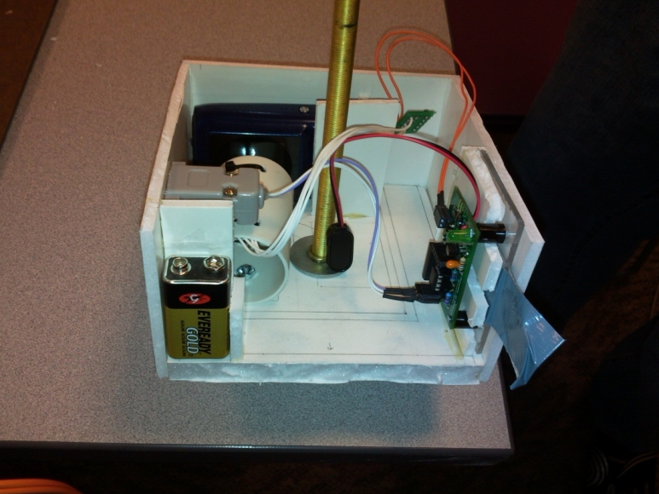
Electronics and Digital Camera Payload
Selected a pre-assembled electronics package
PicAxe 08m processor
Temperature
ViviCam 5118v2 camera
temperature gauge
main circuit board
camera
electronics payload side view

Slide 3
Goals
Design payload components to operate properly throughout the flight
Collect atmospheric altitude and temperature data to investigate the relationship between altitude and temperature

Slide 4
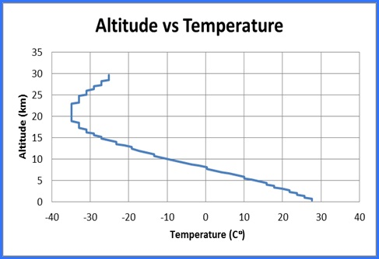
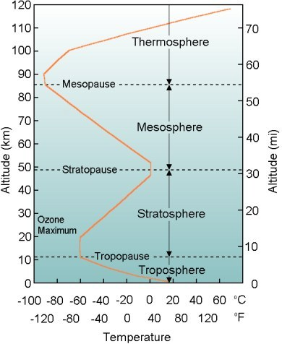
Results
Altitude vs Temperature data resembles similar trend lines of known models
http://www.physics.isu.edu/weather/kmdbbd/unit1_images.htm

Slide 5
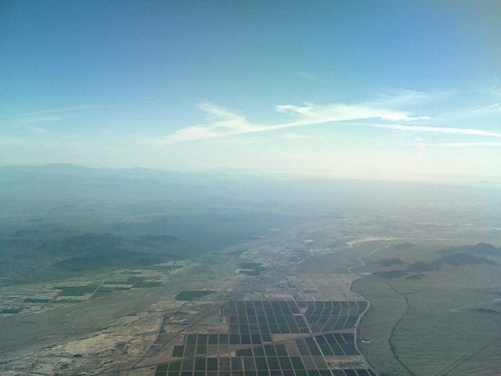
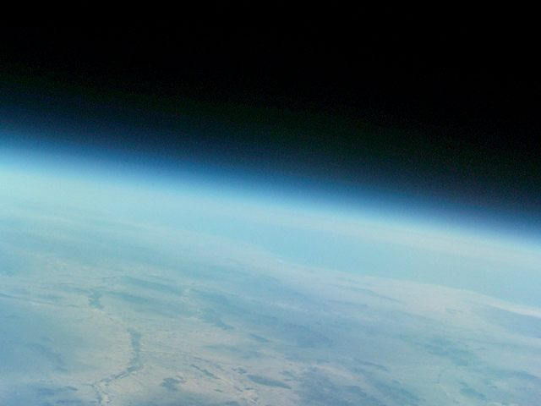
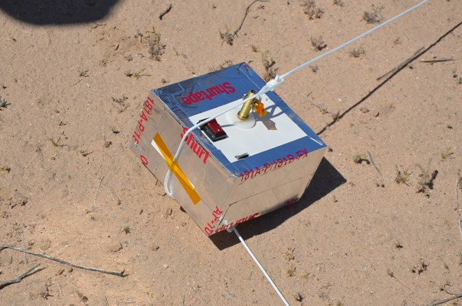
Payload Images
9:11 a.m., 3.73 km (12,244 ft, 2.31 miles)
10:17 a.m., 27.02 km (88,656 ft, 16.79 miles)
Payload after landing

Slide 6
We Learned :
that the temperature in the stratosphere increases with altitude to approximately 20 km then decreases with altitude
how to input and extract data from microprocessor through the PicAxe software
that a UV filter would improve the quality of photos in higher atmosphere
how to solder

Slide 7
Next Launch
Add UV filter to camera to prevent haze
Larger storage and more frequent data sampling for a more accurate reading of the altitude vs temperature graph

Slide 8
Acknowledgements
Special thanks to the following:
Susan Brew and NASA Space Grant Consortium
Jack Crabtree and ANSR
Mike Sampogna, Pima Community College
Dr. Denise Meeks, Pima Community College
8

